Slide 1
WSWG: Personnel Database
XML technology overview and status
Wade Sheldon (GCE)
26-Jul-2011

Slide 2
XML Strategy
The revised LTER personnel database uses REST web services to interact with MySQL backend DB
XML is used for information exchange over WS
Adding/updating personnel records
Searching/retrieving personnel records
XML schema was designed in Feb 2011 workshop to support full DB model (lter-personnelDB.xsd)
stable id
identity info
LTER (NSF) roles and multiple sets of local (site) roles
multiple sets of contact info

Slide 3
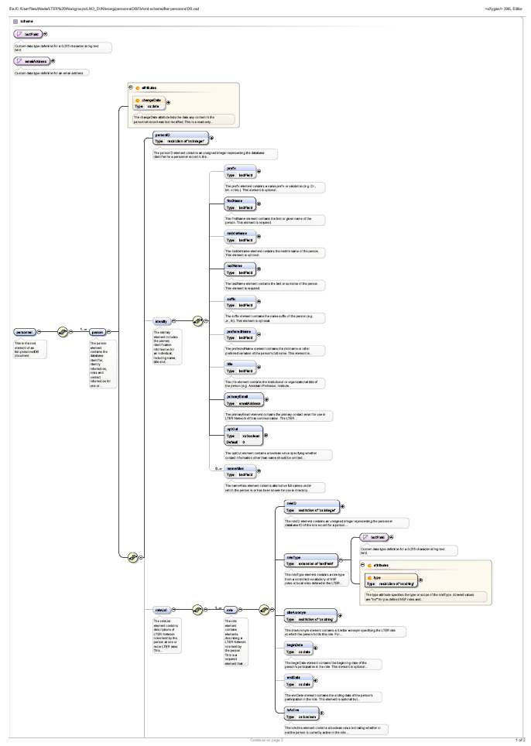
XML Schema
Fully annotated schema in WSWG SVN repository
Links to XSD, diagram, docs on IMC website:
http://im.lternet.edu/news/committees/working_groups/webservices/personnelDB

Slide 4
Supporting Technology
XSLT stylesheets being developed to address use cases
Personnel lists “skinned” for use on site webpages
Live example from GCE (note: uses GCE WS):
XML: http://gce-lter.marsci.uga.edu/gce_metabase/xml/lterPersonnel.xml
Skin 1: http://gce-lter.marsci.uga.edu/...?xsl=xsl/personnel_list_table.xsl
Skin 2: http://gce-lter.marsci.uga.edu/...?xsl=xsl/personnel_list_table2.xsl
EML party elements from database
personnel2eml_creator.xsl → generates EML creator elements
personnel2eml_associated.xsl → generates EML associated party element (XSL parameter used to assign required “role” element)
personnel2emlparty.xsl → generates general EML party elements
all XSLT “flatten” schema and use primary contact info only
Links to XSLT in WSWG SVN on IMC site

Slide 5
Next Steps
User guide (in development)
Javascript “plugin” or example code sites can use to add personnel lists, bio pages to their web pages
More discussion, uses cases from IMC to guide roll-out

